Slide 1
BITS Pilani

Slide 2
Flex/Bison Tutorial

Slide 3
Today’s Learning objective
List the functions of Lexer/Scanner.
Specify regular expressions for C languages tokens.
Write lex code for given specifications

Slide 4
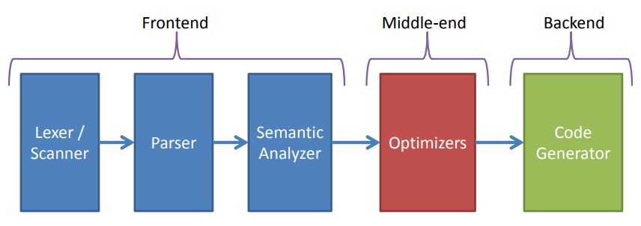
Compiler Overview

Slide 5
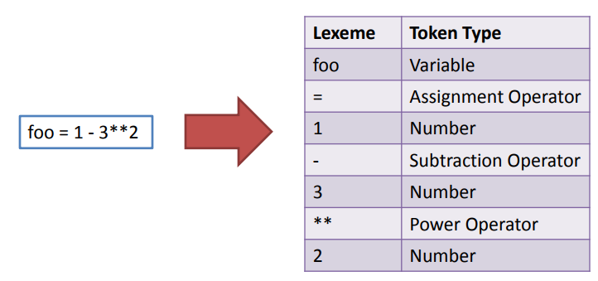
Lexer/Scanner
Lexical Analysis – process of converting a sequence of characters into a sequence of tokens.

Slide 6
Lex/Flex background
lex – is a tool to generator lexical analyzers.
It was written by Mike Lesk and Eric Schmidt (the Google guy).
It isn’t used anymore.
flex (fast lexical analyzer generator)
Free and open source alternative.
You’ll be using this.

Slide 7
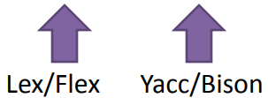
Lex/Flex and Yacc/Bison relation to a compiler toolchain
.l spec file
.y spec file

Slide 8
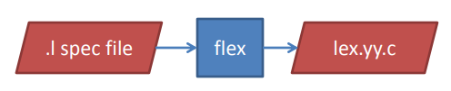
Working of Flex
Flex uses a .l spec file to generate a tokenizer/scanner.
The tokenizer reads an input file and chunks it into a series of tokens which are passed to the parser.

Slide 9
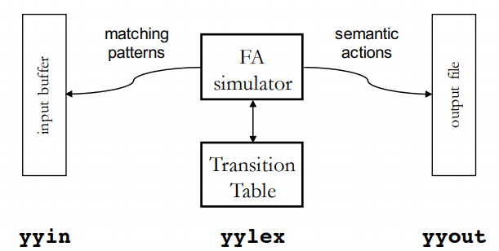
Working of Flex

Slide 10
Flex .l specification file
Definitions Section
%%
Rules Section
%%
User Code(Auxillary) Section
Definitions: All code between %{ and %} is copied to the beginning of the resulting C file.
Two types of definitions:
C code: must be written between %{ %}
Example %{ int count=0; %}
Flex definitions: A definition is very much like a #define cpp directive. For example
letter [a-zA-Z] digit [0-9]
punct [,.:;!?] nonblank [ˆ \t]

Slide 11
Flex .l specification file: Rules section
Rules: A number of combinations of pattern and action: if the action is more than a single command it needs to be in braces.
Each pattern is a regular expression, which may use the regular definitions of the declaration section.
The actions are fragments of code, typically written in C.
Ex:
{letter} { printf(“alphabet”); }
{digit} { printf(“Number”); }
for { printf(“keyword”); }
Pattern { Action(s) }

Slide 12
Flex .l specification file: user code
This can be very elaborate, but the main ingredient is the call to yylex(), the lexical analyser. If the code segment is left out, a default main is used which only calls yylex.
int main()
{
yylex();
user defined functions ;
…….
}

Slide 13
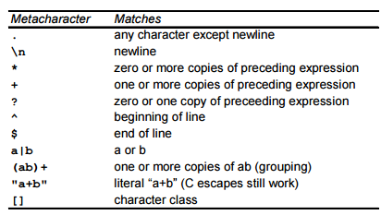
Pattern Matching primitives in flex

Slide 14
Flex specification
Write a flex specification to find whether an input Number is an Integer or a Float. (no leading zeros)
DIGIT [0-9]
NDIGIT [1-9]
PERIOD [.]
%%
{NDIGIT}{DIGIT}*
{NDIGIT}{DIGIT}* {PERIOD} ( {DIGIT})+
%%

Slide 15
LEX: Handling of Regular Expressions
Disambiguating in case of multiple regular expression matching:
Longest input sequence is selected
If same length, first in specification is selected

Slide 16
Rule of longest match
If one RE is a subset of the other then the ambiguity is resolved using this rule.
int8 must be recognized as id not as 2 tokens; keyword and digit
%%
begin printf("Compiler");
beginning printf("Compiler Design");
%%

Slide 17
First rule first
%%
begin printf("Compiler");
[a-z]+ printf("Compiler Design");
%%

Slide 18
Exercise-1
Write a flex specification to count the number of vowels and consonants in a given string.
%{
#include<stdio.h>
int vowels=0;
int cons=0;
%}
%%
[aeiouAEIOU] {vowels++;}
[a-zA-Z] {cons++;}
%%
main(){
printf(“Enter the string: \n”);
yylex();
printf(“No of vowels=%d\nNo of consonants=%d\n”,vowels,cons);
}

Slide 19
Exercise-2
Write a Lex Program to find octal and hexadecimal numbers
Oct [o][0-7]+
Hex [0][x|X][0-9A-F]+
%%
{Hex} printf("this is a hexadecimal number");
{Oct} printf("this is an octal number");

Slide 20
Exercise-3
Write a Lex Program to identify the comments
%%
//(.)* \n
/* (. | \n)* */
%%

Slide 21
Thank you

